Slide 1
Stealth
A Unity Project
By Matthew Zheng And Richard Cao

Slide 2
OVerView
Tutorial On Unity Website: www. Unity3d.com
Please Wait While We Load The Game…

Slide 3
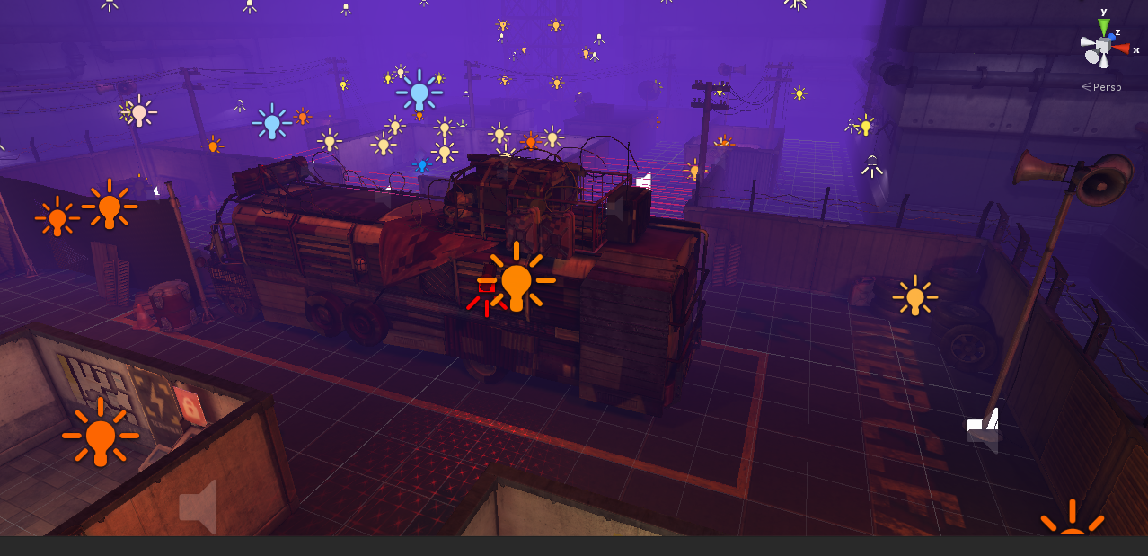
Lesson 1-game setup and Lighting
Basic Gist of Unity:
Created Exterior
Moved Bus Object
Placed Lights
Put Atmosphere(Music)

Slide 4
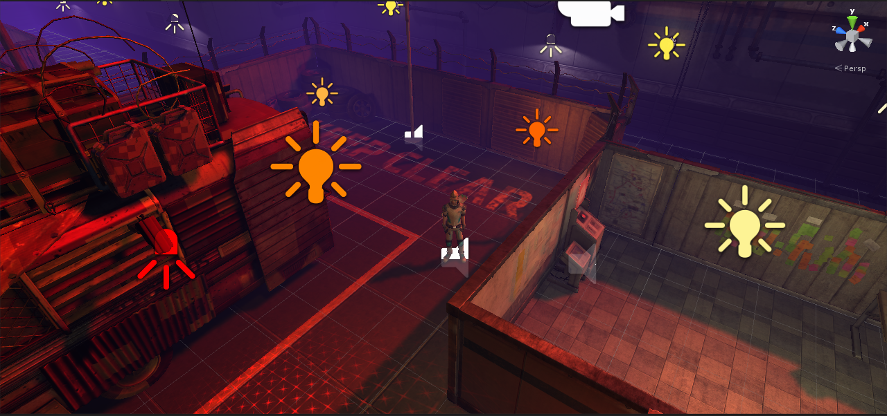
Lesson 2-Alarm Lights
First Time Script With C#
Added Alarm Lights When Alarm Went Off
Added Intense Music

Slide 5
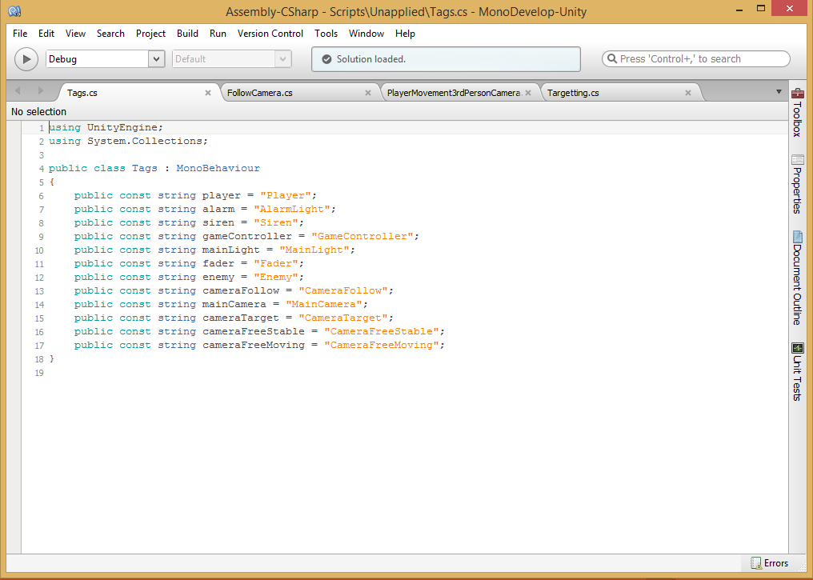
Lesson 3-Tag management
Made Objects Easier To Reference In Other Scripts

Slide 6

Lesson 4 - Screen FAder
Fades Screen For Completion Of Level Or When The Character Dies

Slide 7
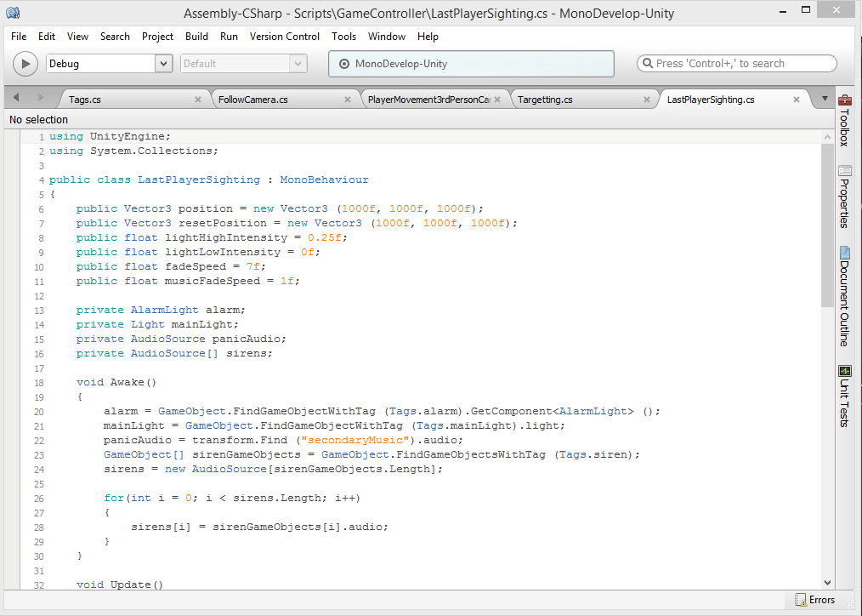
Lesson 5 – Game Controller
Manages Data Used Many Times By Different Scripts
Our Script Manages Music And When Player Is Sighted

Slide 8
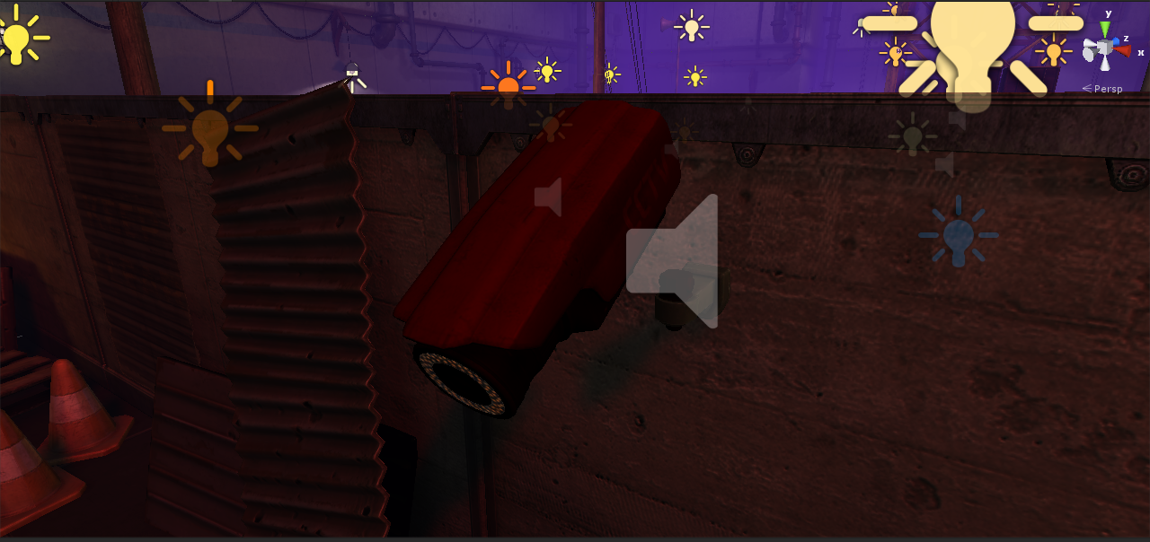
Lesson 6 - Cameras
Made Camera To Sound Alarm If Player Walks Into It

Slide 9
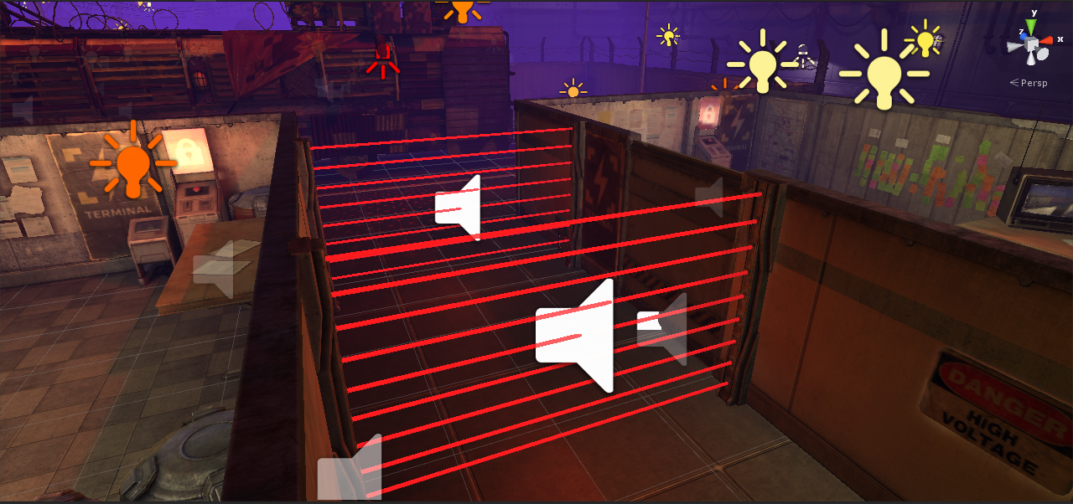
Lesson 7 – Laser Grids
The Player Has To Use Switches To Deactivate The Laser Grids That Will Detect The Player

Slide 10
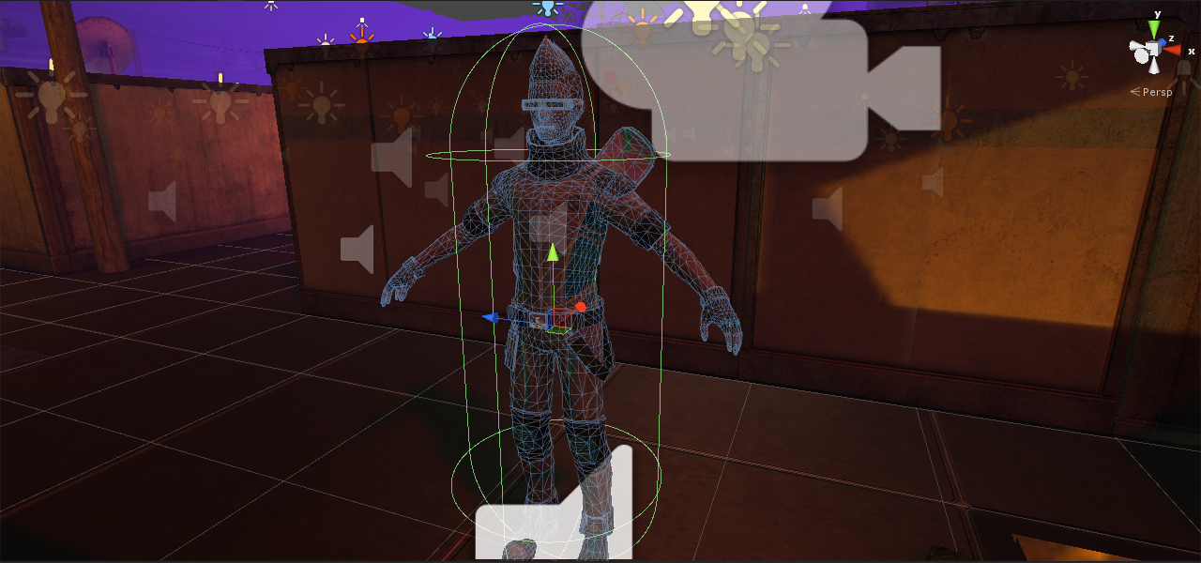
Lesson 8 – Player Setup
Created Colliders To Prevent Collisions With Other Objects

Slide 11
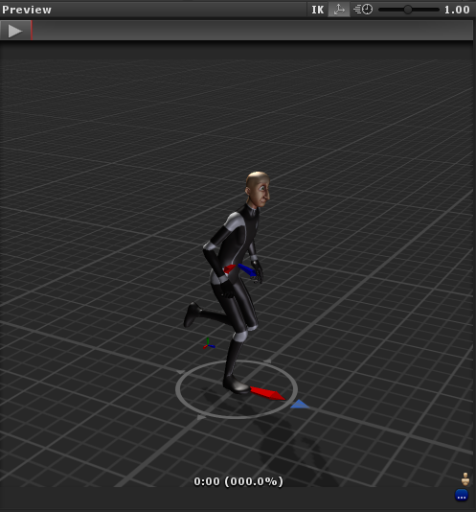
Lesson 9 – player animator controller
Animated The Player From Idle To Moving To Sneak
Also Added Shout Feature

Slide 12
Lesson 10 - HasHIDS
Made Easier References For Future Scripts About Animations

Slide 13
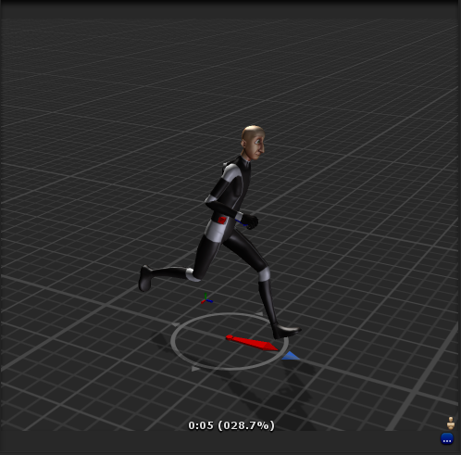
Lesson 11 – Player Movement
We Originally Used There Controls But Removed It

Slide 14
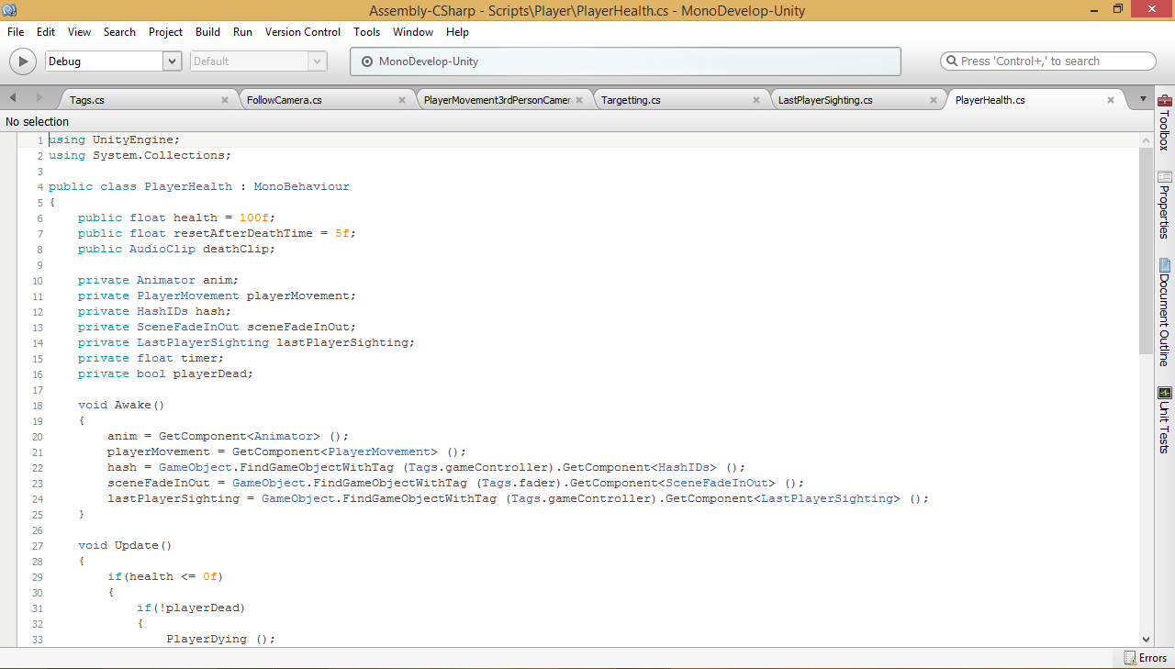
Lesson 12 – Player Health
Back To Coding
Checked Player’s Health And Whether He Is Alive

Slide 15
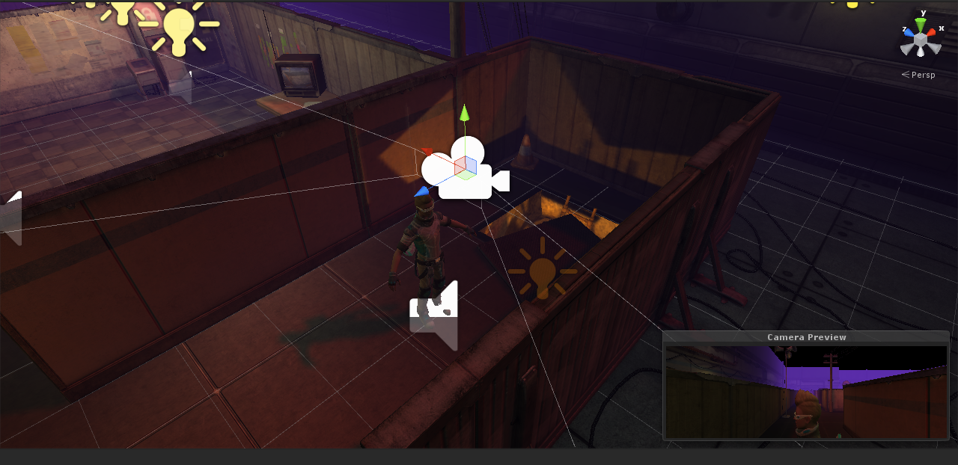
Lesson 13 – Camera Movement
Like Player Movement, We Used Our Knowledge From This To Create Another 3rd Person Camera

Slide 16
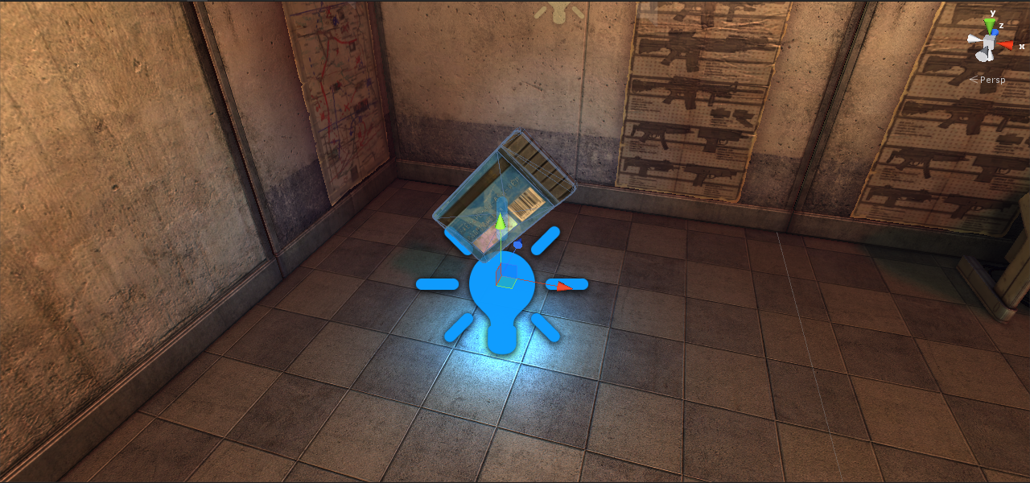
Lesson 14 – Exit Key
Made A Key That The Player Needs To Get Before They Can Finish The Game

Slide 17
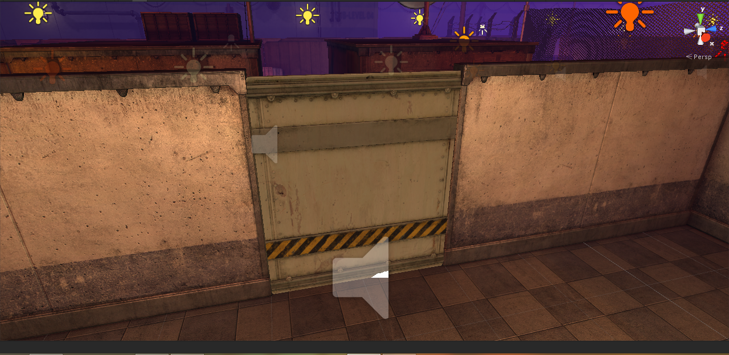
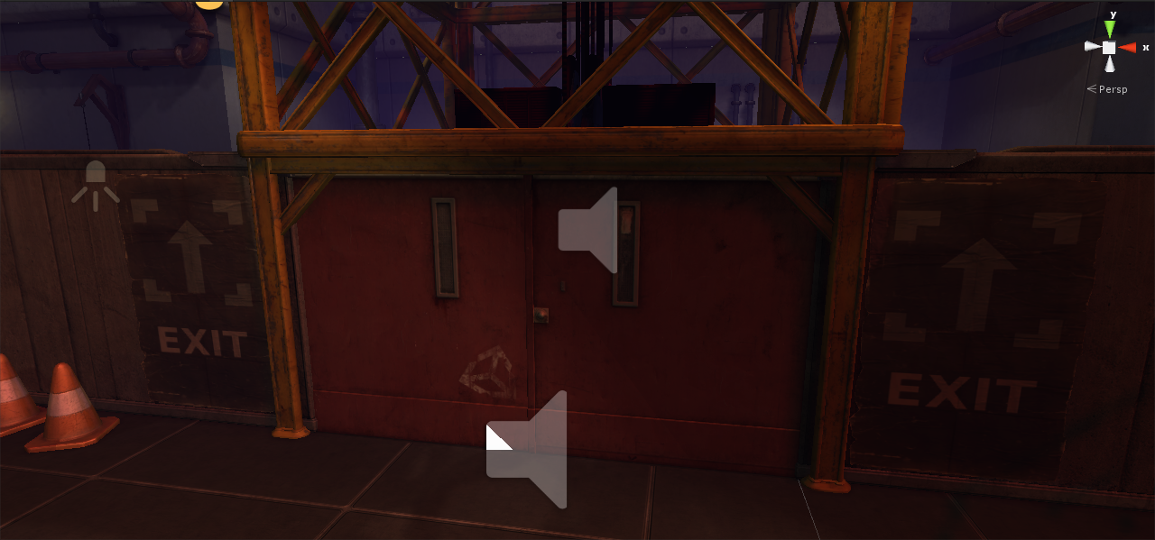
Lesson 15 – Single Doors And Double Doors
Single Door
Double Door

Slide 18
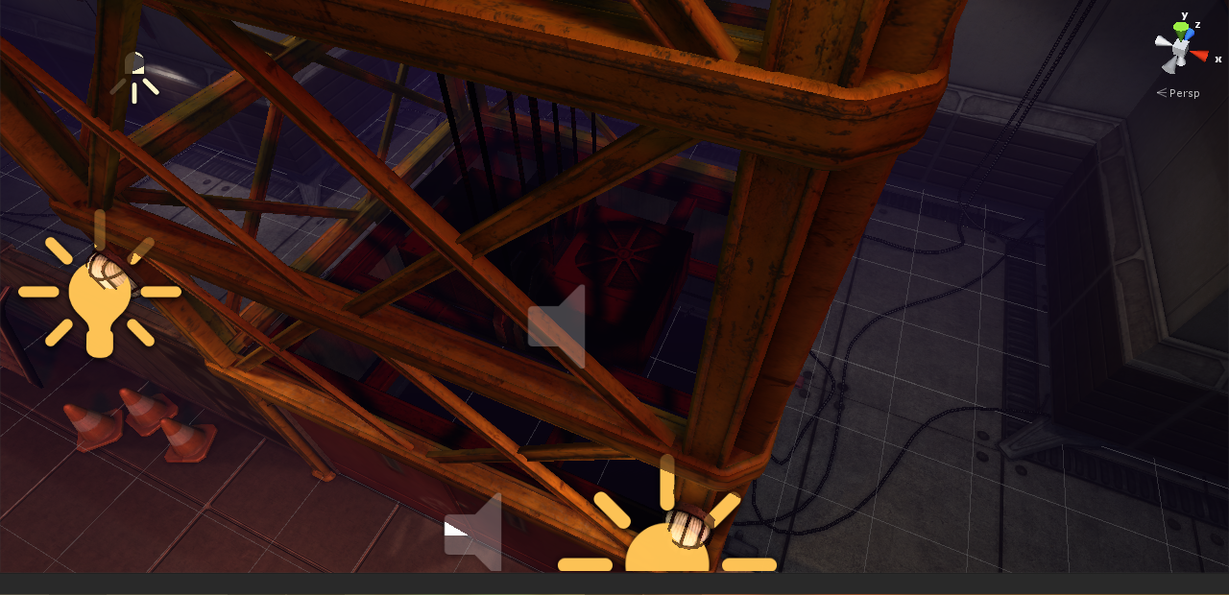
Lesson 16 – The Lift
Made The Elevator Which The Player Needs To Enter To Win

